Slide 1

Team Name : Datavizards
Problem Statement : HeatMap Graph for visualization the market data and predict useful information by using machine learning.

Slide 2



What problem are you solving:
Give a brief of the problem you are solving and the “why” about the project.
Heatmap visualization is surely one of the most effective ways to intuitively show relationships between variables.
So, we make a dashboard which everyone can easy understand the data from the Heatmap.
With a heatmap, you can observe the correlation between variables within your data and find dependencies.

Slide 3
Describe what you are doing:
Give a brief of what are you doing to solve it, basically the “what” about the project.
A heatmap stand apart is the excellent use of colors that contribute to the intuitive understanding of the plot so that user easily understand the concept what the graph tell about.
We also predict the data by machine learning so that we can easily understand the useful data.
We use some sort of big data algorithm so that we handle the big data of market like sector.
We build a Dashboard also.

Slide 4
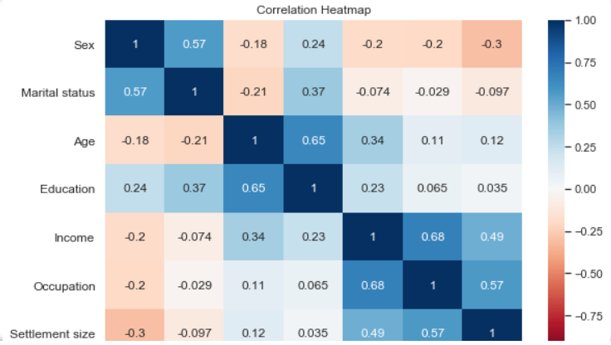
Screenshots of the project:

Slide 5
How scalable is the project?
We build a Dashboard that take “.csv” or “.xls” files that make the heatmap and
pedict the data by ML.
We are trying to make a model which can handle and analysis the big data information also.

Slide 6
Technology used :
Which tech stack you are using and how you are implementing ML, AI, Data Visualization and Big Data.
In this, we are using Data Visualization from python programming and their libaries such as NumPy, Seaborn, Pandas, Matplotlib, Sklearn mainly.
From ML, we predicting some data like market goes up or down from previous data and many more predicting information as we can do.
We use big data to store and analysising the data because the market data is very large and their are many things that are involved.

Slide 7

THANK YOU

